Slide 1
Descriptor Structure
erst mal gut
Working title: ViewPlorer

Slide 2
Documents, Directories and their Descriptors
physical
directory
directory
descriptor
descriptor archive
physical
file
file
descriptor
file A
descriptor A
ZIP
directory
descriptor
zip
directory
file B
descriptor B
shadow
file
shadow
descriptor C
ZIP
shadow
descriptor C
zip
directory
descriptor zip
shadow
file

Slide 3
Documents, Directories and their Descriptors
Directory of the file system, that includes documents and directories.
Physical file, like doc, xls, ppt, pdf, txt, mp3, vob, mj, etc.
Zip directory is handled like an ordinary directory.
Shadow file is stored within a central document management, it is missing within the current directory.
File descriptor describes, categorize and identifies the associated file.
Directory descriptor describes the content and the categorization of the associated directory. It identifies it.
Shadow descriptor includes the information of the file and the directory descriptor, respectively. However, the associated file or directory is not deployed to the archive.
physical
directory
file
descriptor
directory
descriptor
physical
file
ZIP
zip
directory
shadow
descriptor C
shadow
file

Slide 4
De-central Descriptors
Descriptor consist of:
  Common file and directory description
  Category path dependent file description
  Categorization using category paths which can be visualized
  DescriptorId for distributed manipulation of categorization
  CategoryId for distributed manipulation of categories
  ??? UserId

Slide 5
De-central Descriptors
Descriptors for each file and directory stored within the directory structure of the associated file and directory, respectively.
Advantages:
  The user can move, copy or rename directories with standard tools (e. g. file explorer).
  The user can partly deploy directories and files based on the file system: the meta information is still associated to the file and directories and can be visualized using VIEWPLORER.
Benefits:
  Departments can successively introduce VIEWPLORER within the department or enterprise
  The user can use standard tools for directory manipulations, backups, indexing, version control systems, and ???
  The user can deploy files and directories to third parties, which do not use VIEWPLORER and save license expenses.

Slide 6
De-central Descriptors
Supports partly deployment without losing information by using shadow descriptors for not deployed files and directories.
Advantages:
  The user sees all category views complete independent of completeness of the deployed files and directories.
Benefits:
  The user can categorize new files without having to have all files and directories of the global archive.

Slide 7
De-central Descriptors
Checksum checker of the associated file or directory
Advantages:
Benefits:

Slide 8
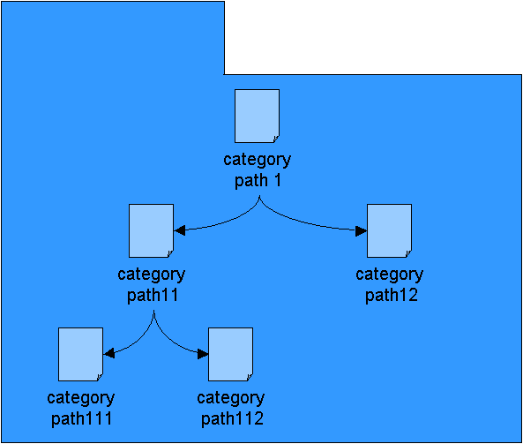
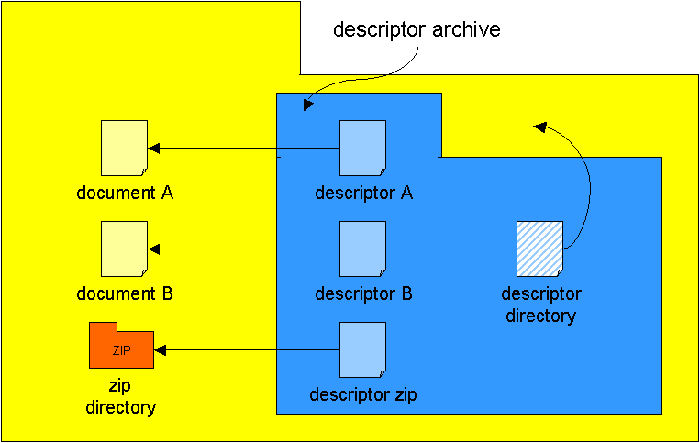
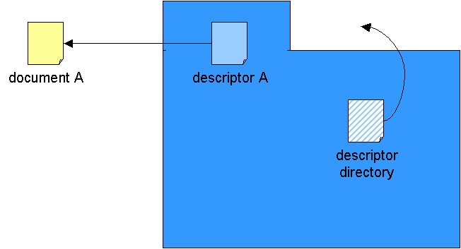
Views and Category Paths
physical view
logical view 1
logical view 2

Slide 9
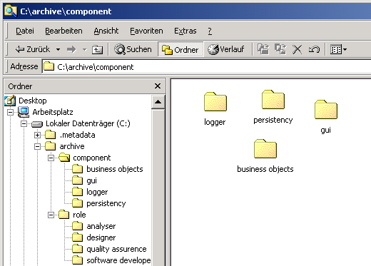
Example of Views
Muss noch erstellt werden

Slide 10
Favorites
Favorites
logical view

Slide 11
To do‘s
Defining the structure of the descriptor archive: ZIP or directory
Handling user defined category views within multi-user environment
Handling descriptor archives for ZIPed archives.

Slide 12
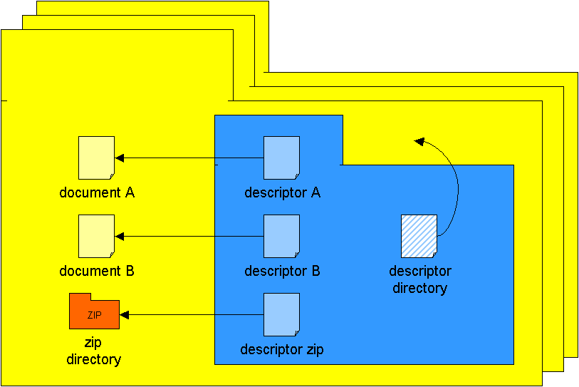
Bildersturm
physical
directory
Descriptor
file
physical
document
descriptor
directory
category
path 1
ZIP
zip
directory
category
path11
category
path12
category
path111
category
path112

